Slide 1
Attacking an Insecure Blazor Application
Chris Cumming

Slide 2


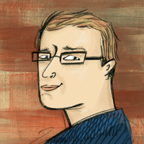

Who am I? (i.e. Shameless Self Promotion)
Software Consultant https://saturdaymp.com chris.cumming@satudaymp.com Virtual Chat Host http://weeklydevchat.com/ https://www.legacycode.rocks/
Slacks Chris C on Dev Edmonton Legacy Code Rocks YegSec
Notes:
I’m a software consultant that helps small to medium sized businesses get software out the door
Any other software developers?
I’ve been working on expanding my security knowledge. I have knowledge on how to write secure software but want to expand it to servers, networks, etc.
Sub-contract with Corgibytes and one of their clients inspired this talk.
I also run and host the Weekly Dev Chat. I also co-host the Legacy Code Rocks virtual meetup.

Slide 3
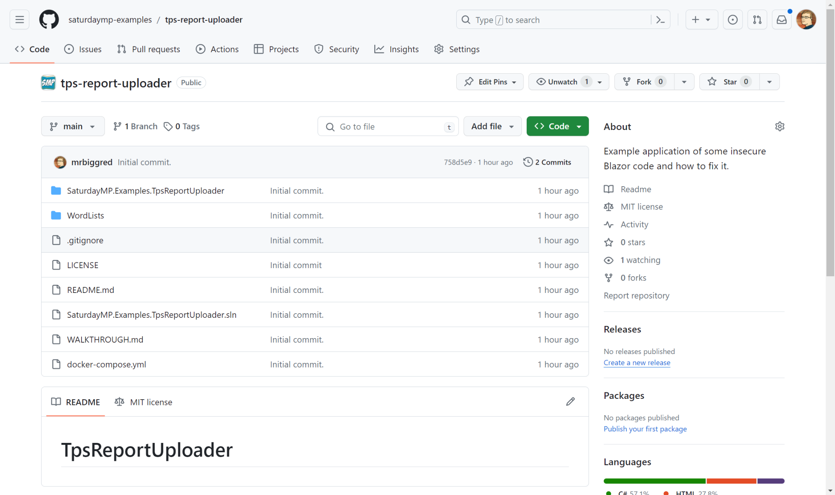
Example Repo
If you want to follow along or experiment after the talk:
https://github.com/saturdaymp-examples/tps-report-uploader

Slide 4
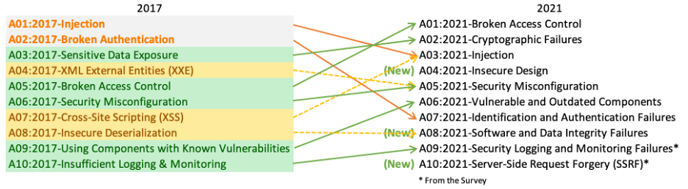
Open Web Application Security Project (OWASP)
Top 10 security issues and DotNet security tips:
https://owasp.org/www-project-top-ten/
https://cheatsheetseries.owasp.org/cheatsheets/DotNet_Security_Cheat_Sheet.html
Notes:
Lots of connections is often bots, scripts, etc. Usually not good or not a user.

Slide 5

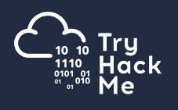
Hands on Learning
https://hackthebox.com/
https://tryhackme.com/
https://tryhackme.com/r/christmas
Notes:
nginx [engine x] is an HTTP and reverse proxy server, a mail proxy server, and a generic TCP/UDP proxy server,
Fail2ban scans log files (e.g. /var/log/apache/error_log) and bans IPs that show the malicious signs -- too many password failures, seeking for exploits, etc.
Fail2Ban works by parsing log files looking for certain messages. If it sees a X messages in a given time frame it will ban the IP via iptables.

Slide 6
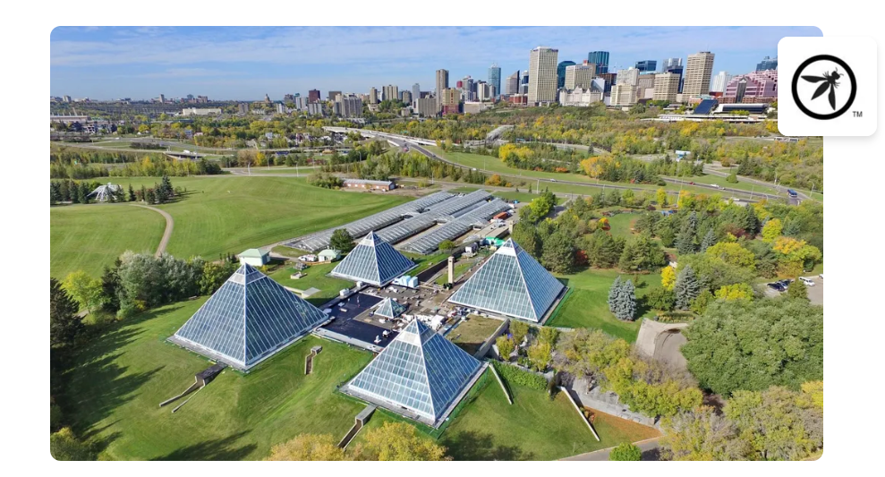

Local Security Groups
https://www.yegsec.ca/
https://www.meetup.com/meetup-group-opbybwve/

Slide 7
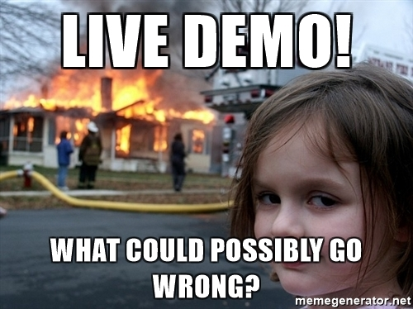
Live Demo!
https://github.com/saturdaymp-examples/tps-report-uploader

Slide 8
Learn More
GitHub Repo and Tutorials https://github.com/saturdaymp-examples/tps-report-uploader https://owasp.org/www-project-top-ten/ https://cheatsheetseries.owasp.org/cheatsheets/DotNet_Security_Cheat_Sheet.html
Contact chris.cumming@satudaymp.com Chris C on Slack: Dev Edmonton Legacy Code Rocks YegSec

